Slide 1
OCR PROJECT PYTHON
Done by
R.BARATHKUMAR
SRI VENKATESWARA COLLEGE OF ENGINEERING

Slide 2
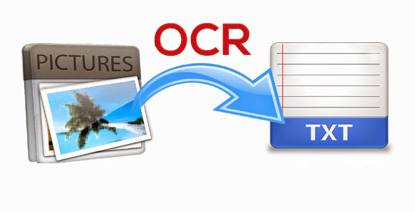
Optical Character Recognition, or OCR, is a technology that enables you to convert different types of documents, such as scanned paper documents, PDF files or images captured by a digital camera into editable and searchable data.

Slide 3
Key features of my OCR WEBPAGE
Document conversion
Convert JPG image file into searchable and editable formats (text)
Platform-independent service
Website works in both desktop and mobile in both microsoft and ios
Words Identification
Identifies some important words in uploaded text file

Slide 4
WEBSITE WORKING
The webpage displays the upload button where the user can upload the image to be converted.
On clicking the upload button the website converts the image to text file
clicking the download button user can download the converted text file.
The webpage also displays some of the important words in the text file.

Slide 5
Used HTML and CSS to create the webpage.
For database - used flask SQLALchemy(sqlite).
By installing and importing pytesseract-converted jpg image to text(OCR).
Used some python concepts(list,for loop,if,logical operations,inbuild functions)-to find some important words in text file.

Slide 6
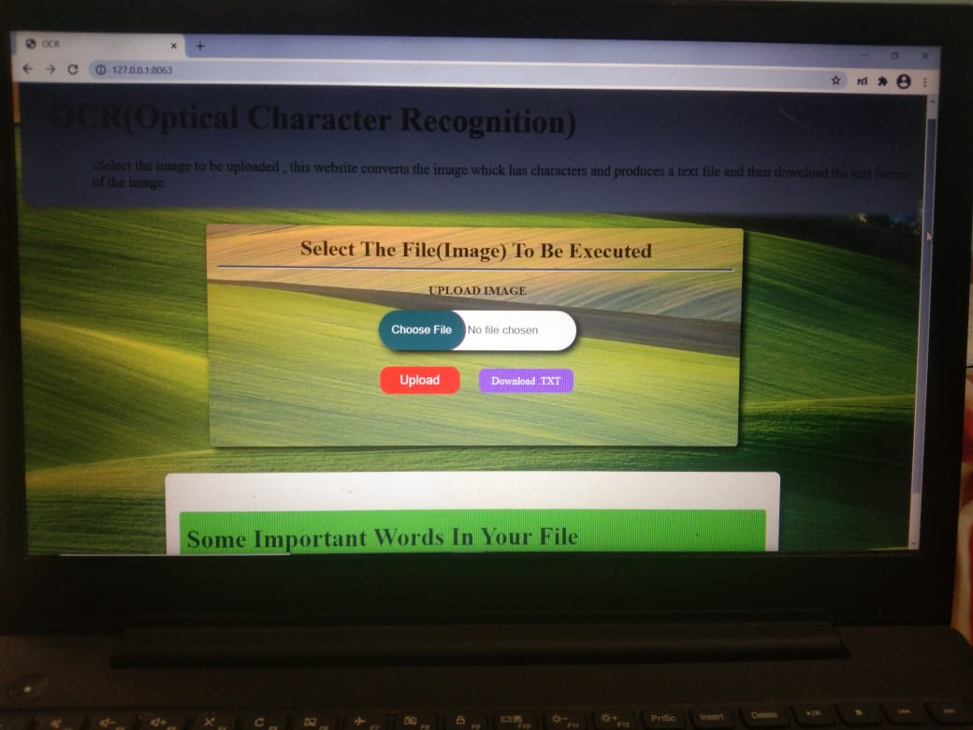
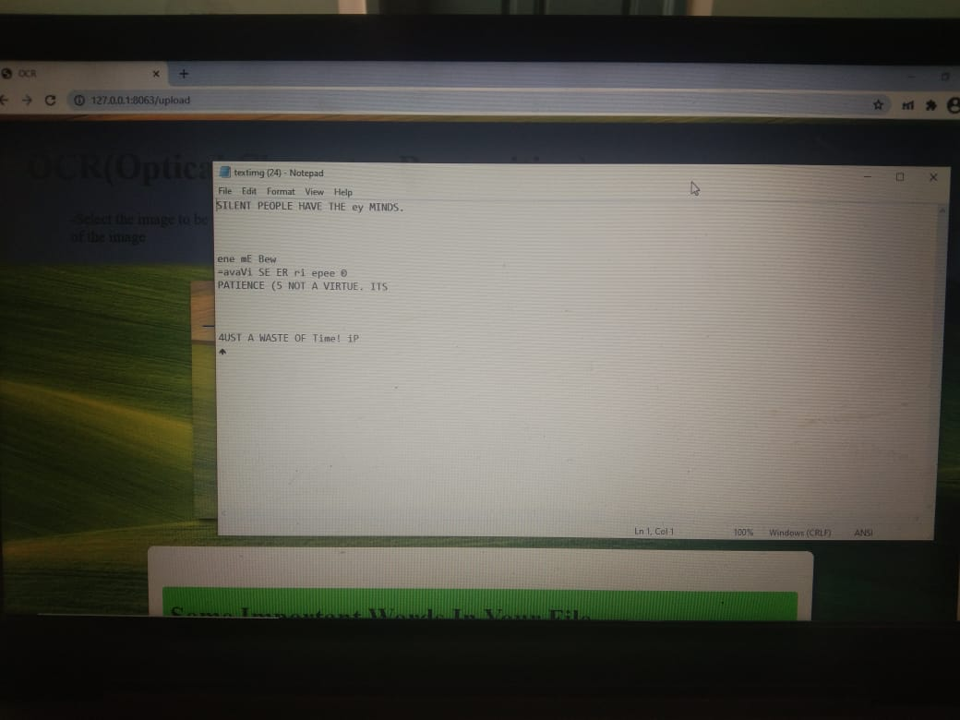
WEBSITE DESIGN
Main Page
With upload and download button
Downloaded text file

Slide 7
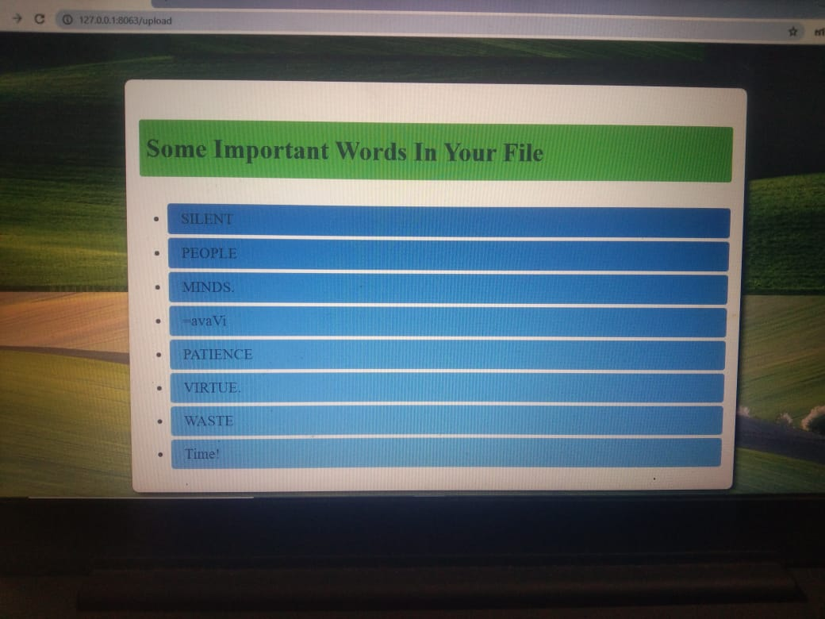
After uploading the file ,the webpage also displays some important words in the text file

